Slide 1


Functional programming in concurrent and distributed systems
381-1-0112 | SM B 2021| Tutorial 6
David Leon

Slide 2
Outline
Process Dictionary
Directed Graphs
Submission Procedures

Slide 3
#1 Process Dictionary
Each process has a local store called the “process dictionary”
The following BIFs are used to manipulate the process dictionary:
get() returns the entire process dictionary
get(Key) returns the item associated with Key or atom undefined
put(Key, Val) associate Val with Key. Returns old value of Key
erase() erases the entire process dictionary
erase(Key) erases the value associated with Key
get_keys(Value) returns a list of all keys whose associated value is Val

Slide 4
#1 Process Dictionary
Type the following commands and understand the results
put(x,90).
get(x).
put(11,a).
get().
put(a,90).
get_keys(90).
erase(11).
Is there any assignment of variables in these commands?

Slide 5
#2 Directed Graphs
A data structure that is implemented in Erlang
Directed graphs in Erlang are implemented in two modules
digraph
Constructing and modifying directed graphs: Manipulating edges and vertices, finding paths and cycles, etc.
digraph_utils
Navigating through a graph (post-order, pre-order), testing for cycles, arborescence or trees, finding neighbors, etc.
Explore these modules in Erlang documentation sites! Refs: here and here

Slide 6
#3 Submission Procedures
Only a single .erl file to be submitted
Filename format: ex6_<ID>.erl
Where <ID> needs to be replaced with your ID number
Your code MUST be well documented
Functions’ names must be identical to the ones defined in exercise
Same as for the arity
Same as for the output format
Only the tested functions needs to be exported
Internal functions MUST NOT be exported
Assignments will be tested automatically in using Erlang shell in Linux
No excuses

Slide 7
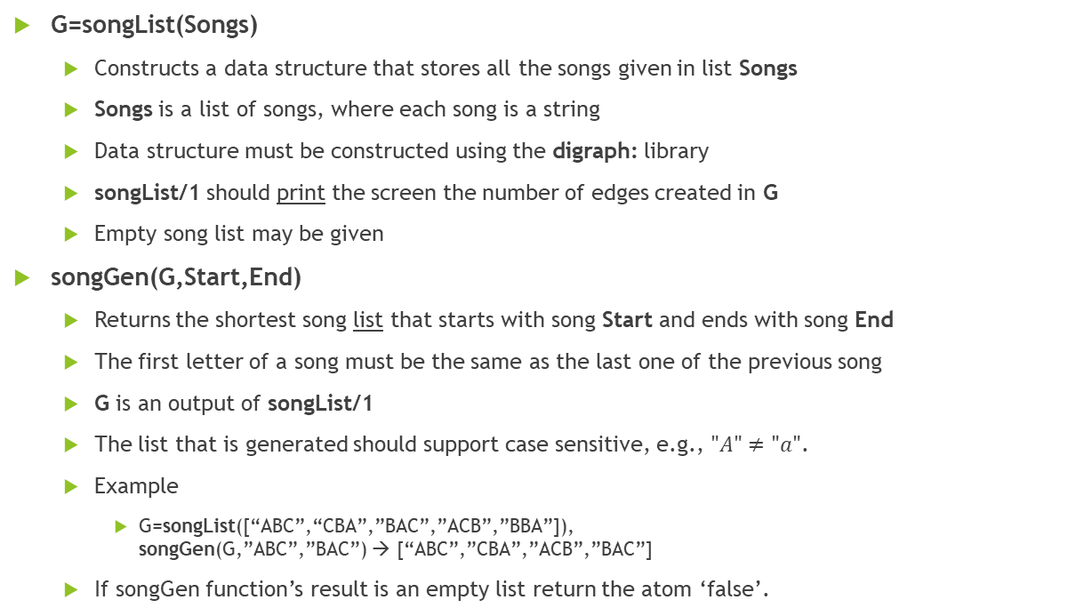
Exercise 6
G=songList(Songs)
Constructs a data structure that stores all the songs given in list Songs
Songs is a list of songs, where each song is a string
Data structure must be constructed using the digraph: library
songList/1 should print the screen the number of edges created in G
Empty song list may be given
songGen(G,Start,End)
Returns the shortest song list that starts with song Start and ends with song End
The first letter of a song must be the same as the last one of the previous song
G is an output of songList/1
The list that is generated should support case sensitive, e.g., $"A"≠"a"$.
Example
G=songList([“ABC”,“CBA”,”BAC”,”ACB”,”BBA”]), songGen(G,”ABC”,”BAC”) → [“ABC”,”CBA”,”ACB”,”BAC”]
If songGen function’s result is an empty list return the atom ‘false’.

